Slide 1
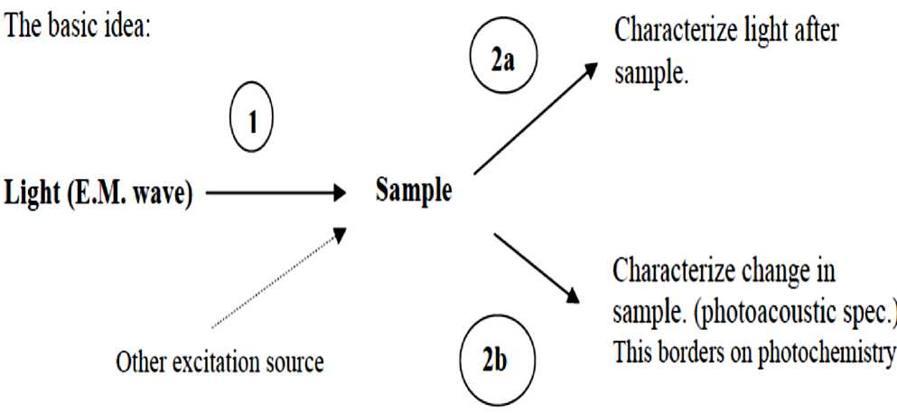
Lecture 14
Dr. Mohammed Abdul Baset
Spectroscopy
What is spectroscopy?
Spectroscopy is the study of the interaction between electromagnetic radiation and matter Latin, “spectrum”—ghost or spirit Greek. “aKorcsiv” —to look carefully
■ With light, you aren’t looking directly at the molecule—the matter—but its “ghost.” You observe the light’s interaction with different degrees of freedom of the molecule. Each type of spectroscopy—different light frequency—gives a different picture ^ the spectrum.
■ The spectrum is the variation of the intensity of the radiation as a function of the frequency or wavelength.
■ Spectroscopy is a general methodology that can be adapted in many ways to extract the information you need (energies of electronic, vibrational, rotational states, structure and symmetry of molecules, dynamic information).
What does a spectrum measure?
Interaction of light with a sample can influence the sample and/or the light.
Method involves: (1) excitation and (2) detection.
70

Slide 2
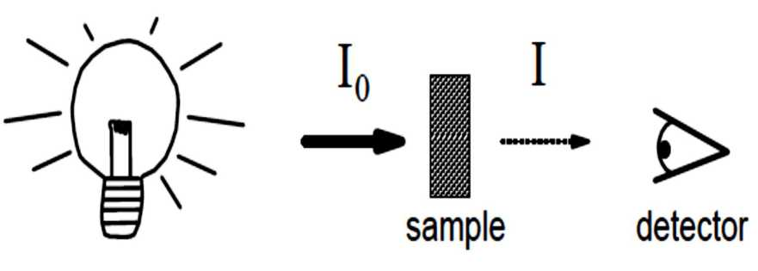
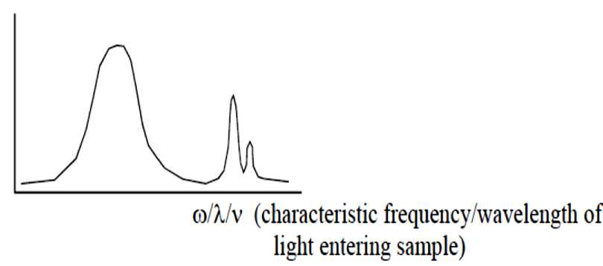
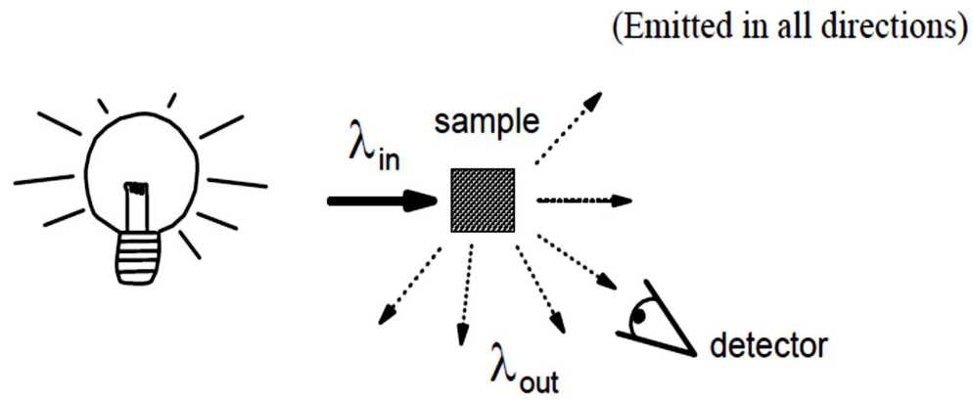
We measure the absorption of light at different frequency or wavelength.
2) Emission: Excitation induces emission of light from the sample (usually of different frequency).
Includes: Fluorescence (emission from excited electronic singlet states)
Phosphorescence (emission from excited electronic triplet states)
Raman Scattering (light scattering involving vibrational transition)
3) Optical Rotation: Change of phase of light incident on sample (rotation of polarization)
Let’s work on describing absorption.
71

Slide 3
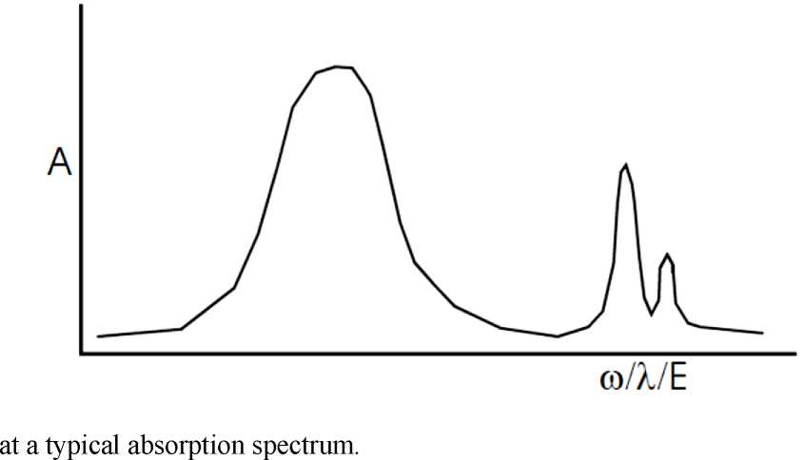

Let’s look
Optical spectroscopy
1.
2.
3.
4.
Optical spectroscopy is a means of studying the properties of physical objects based on measuring how an object emits and interacts with light.
It can be used to measure attributes such as an object's chemical composition, temperature, and velocity.
It involves visible, ultraviolet, or infrared light, alone or in combination, and is part of a larger group of spectroscopic techniques called electromagnetic spectroscopy.
Almost zero momentum transfer because of speed of light
5. Optical spectroscopy is an important technique in modern scientific fields such as chemistry and astronomy.
72

Slide 4
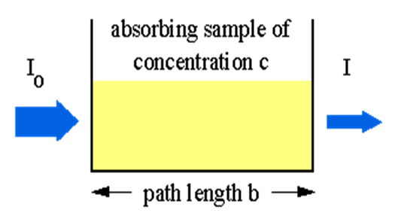
6. Optical spectroscopy gives information about energy transitions in solids (bandgaps, phonons, plasmons, magnons, impurity states, ...)
7. The whole frequency spectrum is important, and different ranges require different techniques and instruments
8. If reflectance is measured over a wide frequency range, Kramers-Kronig relations can be used to determine one of the (interconvertible) complex response function
9. Ways to measure I (ω ) : Grating spectroscopy, Fourier Transform spectroscopy
10. Raman spectroscopy measures inelastic scattering and is complementary to absorption studies
Beer-Lambert Law
The Beer-Lambert law (or Beer's law) is the linear relationship between absorbance and concentration of an absorbing species. The general Beer-Lambert law is usually written as: A = a(lambda) * b * c
where A is the measured absorbance, a(lambda) is a wavelength-dependent absorptivity coefficient, b is the path length, and c is the analyte concentration. When working in concentration units of molarity, the Beer-Lambert law is written as:
A = epsilon * b * c
where epsilon is the wavelength-dependent molar absorptivity coefficient with units of M⁻¹ cm⁻¹.
Instrumentation
Experimental measurements are usually made in terms of transmittance (T), which is defined as: T = I / Io
where I is the light intensity after it passes through the sample and Io is the initial light intensity. The relation between A and T is:
A = -log T = - log (I / Io ).
Modern absorption instruments can usually display the data as either transmittance, % transmittance, or absorbance. An unknown concentration of an analyte can be determined by measuring the amount of light that a sample absorbs and applying Beer's law. If the absorptivity coefficient is not known, the unknown concentration can be determined using a working curve of absorbance versus concentration derived from standards.
73

Slide 5
Limitations of the Beer-Lambert law
The linearity of the Beer-Lambert law is limited by chemical and instrumental factors. Causes of nonlinearity include:
• deviations in absorptivity coefficients at high concentrations (>0.01M) due to electrostatic interactions between molecules in close proximity
• scattering of light due to particulates in the sample
• fluoresecence or phosphorescence of the sample
• changes in refractive index at high analyte concentration
• shifts in chemical equilibria as a function of concentration
• non-monochromatic radiation, deviations can be minimized by using a relatively flat part of the absorption spectrum such as the maximum of an absorption band
• stray light
74

